Slide 1
Range Map Lit Review - Carly Brooks
Table of Contents
Slides 2-3 - Gray Wolf
Slide 4 - African Lion
Slide 5 - Coyote
Slide 6 - Gray Fox
Slide 7 – Bobcat
Slides 8-12 – Grizzly Bear
Slide 13 - Mule Deer/White-tailed Deer
Slide 14 - Moose
Slide 15 - Eastern Spotted Skunk
Slides 16-18 - Mountain Lion
Slide 19 - Brown Hyena
Slides 20-21 - Wolverine
Slide 22 - Timber Rattlesnake
Slide 23 – Snow Leopard
Slide 24 – Common Raven
Slide 25 – References

Slide 2
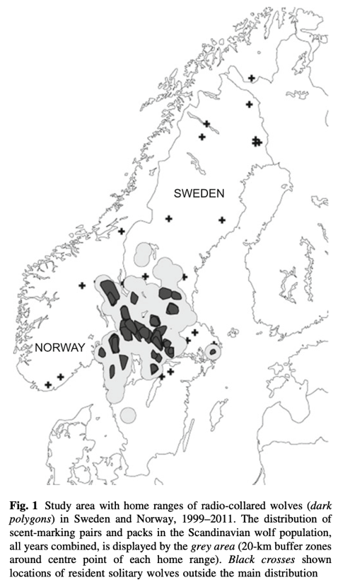
Gray Wolf
Mattisson et al. 2013 - Home range size variation in a recovering wolf population: Evaluating the effect of environmental, demographic, and social factors.
Major findings: Roe deer density, elevation and latitude were important variables predicting wolf home range size. Social factors such as wolf density and competition did not influence range size.

Slide 3
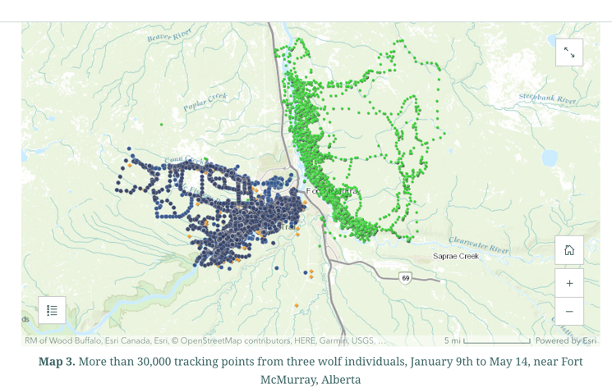
Gray Wolf
Esri Canada. (2024). Wolf Tracks: More than 30,000 tracking points from three wolf individuals, January 9th to May 14, near Fort McMurray, Alberta. ArcGIS StoryMaps. Retrieved from https://storymaps.arcgis.com/stories/32412cf13731440582fe051cd360b009

Slide 4
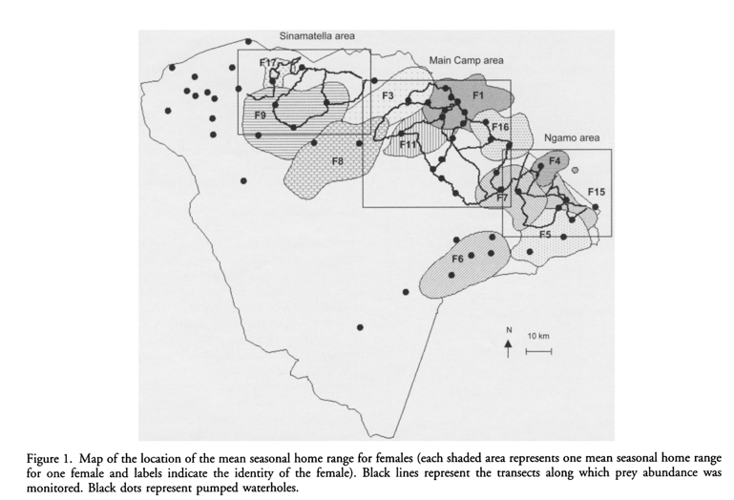
African Lion
Loveridge et al. 2009 - Changes in home range size of African lions in relation to pride size and prey biomass in a semi-arid savanna.
Major findings: Female home range size increased as pride biomass increased, which could suggest expansionism. Once controlled for pride biomass, home range size decreased as prey biomass increased.

Slide 5
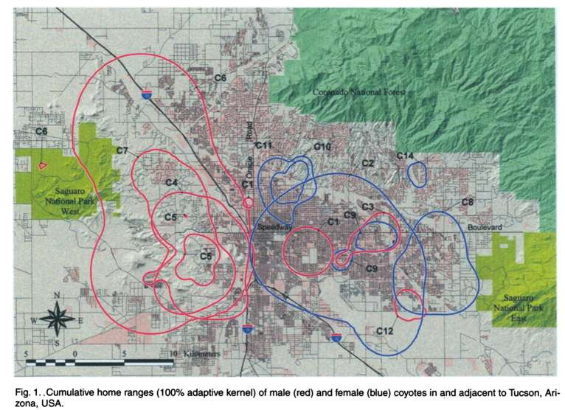
Coyote
Grinder & Krausman 2001 - Home Range, Habitat Use, and Nocturnal Activity of Coyotes in an Urban Environment.
Major findings: Found no statistically significant difference in home range size by sex or season. Coyote home ranges were stable through time, likely due to the abundance of food in the urban study area.

Slide 6
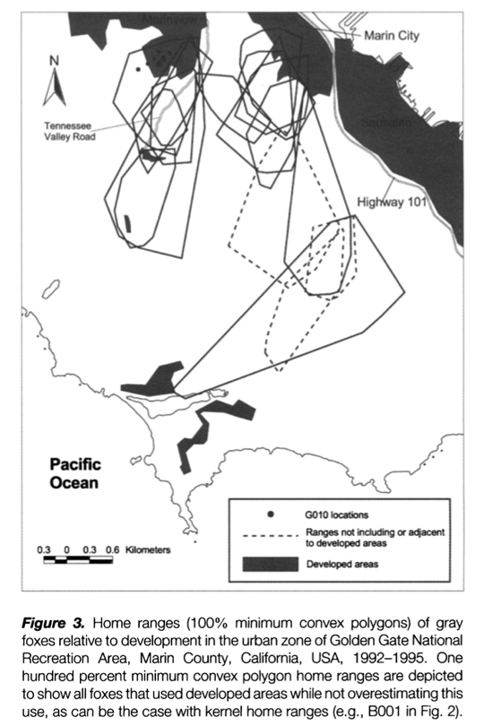
Gray Fox
Riley 2006 - Spatial Ecology of Bobcats and Gray Foxes in Urban and Rural Zones of a National Park.
Major findings: Home range size and overlap were not significantly different between urban and rural zones.

Slide 7
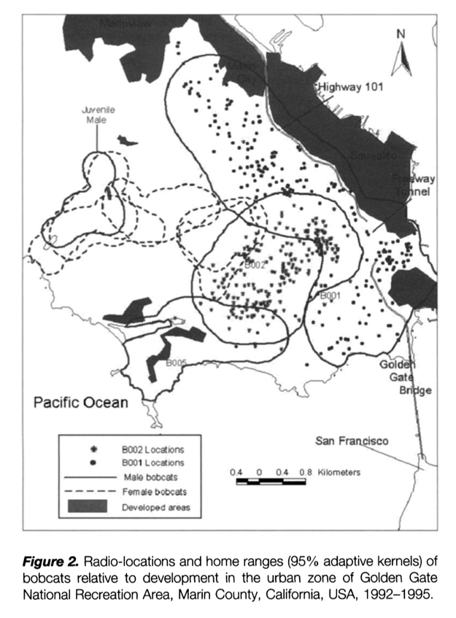
Bobcat
Riley 2006 - Spatial Ecology of Bobcats and Gray Foxes in Urban and Rural Zones of a National Park.
Major findings: Home range size decreased in urban zones, but home range overlap increased.

Slide 8
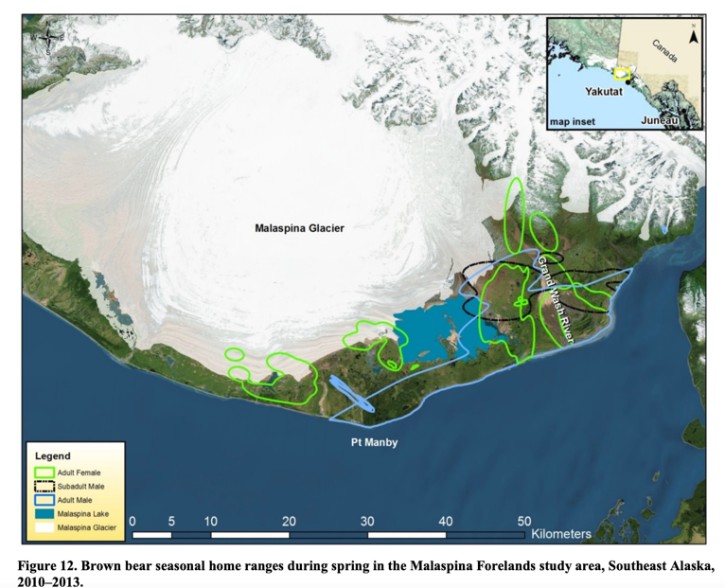
Grizzly Bear
Crupi et al. 2014 - Movement Patterns, Home Range Size, and Resource Selection of Brown Bears Near the Malaspina Glacier, Southeast Alaska
Major findings: Authors found no significant difference between male and female minimum convex polygon home range size estimates, but seasonal kernel density estimates of male home ranges were larger than females. Both reproductive status and season were important predictors of home range size.
Spring Ranges

Slide 9
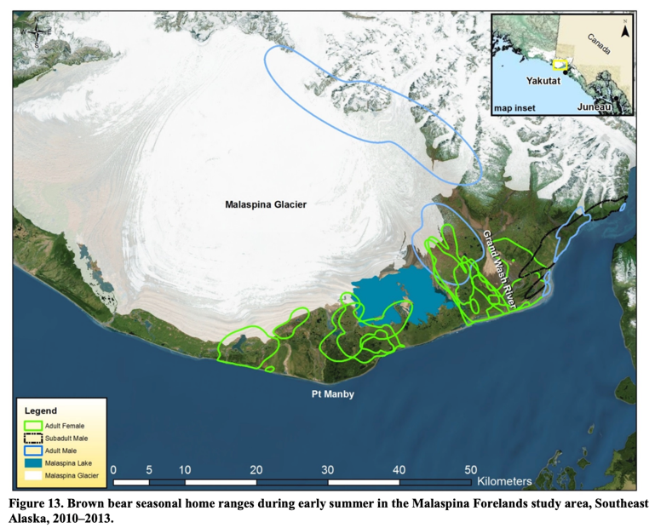
Grizzly Bear
Crupi et al. 2014 - Movement Patterns, Home Range Size, and Resource Selection of Brown Bears Near the Malaspina Glacier, Southeast Alaska
Early Summer Ranges

Slide 10
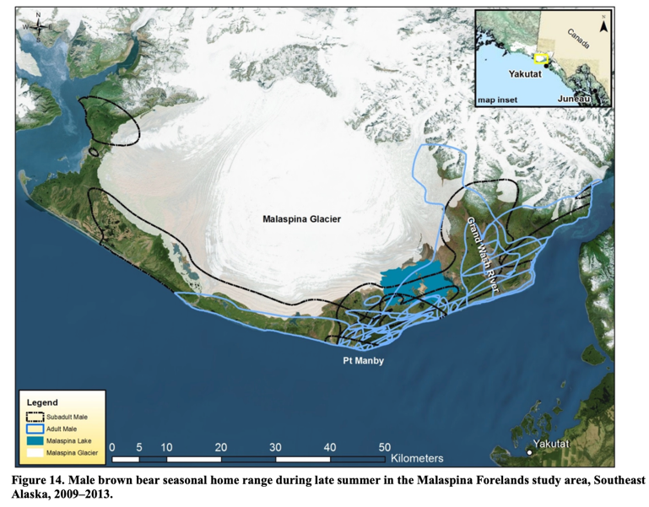
Grizzly Bear
Crupi et al. 2014 - Movement Patterns, Home Range Size, and Resource Selection of Brown Bears Near the Malaspina Glacier, Southeast Alaska
Late Summer Ranges - Males

Slide 11
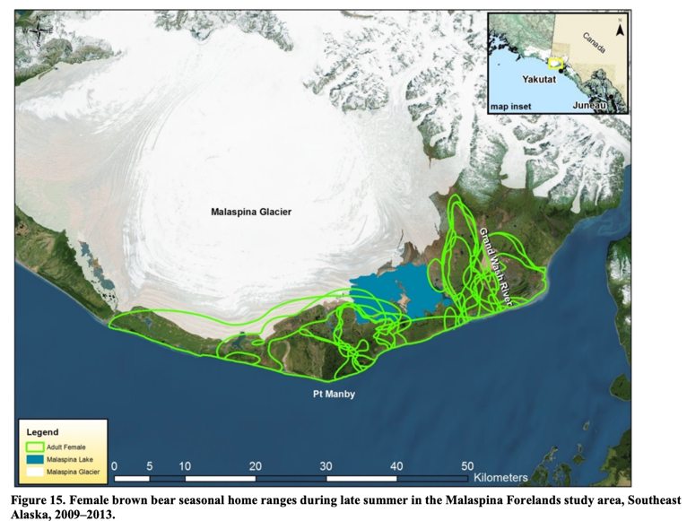
Grizzly Bear
Crupi et al. 2014 - Movement Patterns, Home Range Size, and Resource Selection of Brown Bears Near the Malaspina Glacier, Southeast Alaska
Late Summer Ranges - Females

Slide 12
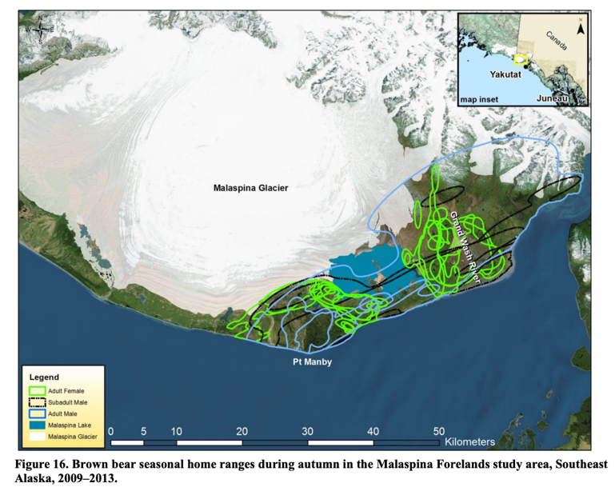
Grizzly Bear
Crupi et al. 2014 - Movement Patterns, Home Range Size, and Resource Selection of Brown Bears Near the Malaspina Glacier, Southeast Alaska
Autumn Ranges

Slide 13
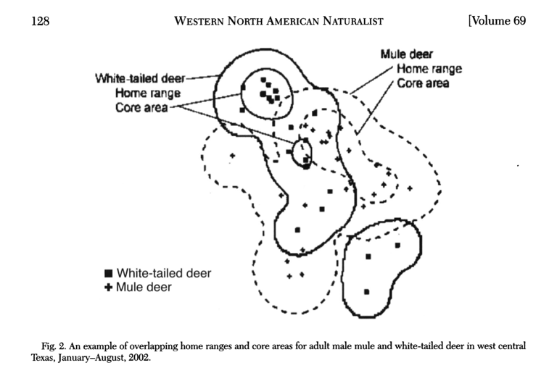
Mule Deer/White-tailed Deer
Brunjes et al. 2009 - Home-range size and overlap of sympatric male mule and white-tailed deer in Texas.
Major findings: Home range sizes of mule deer and white-tailed deer were similar. The home range of every study animal was overlapped by the home range of more than one other study animal.

Slide 14
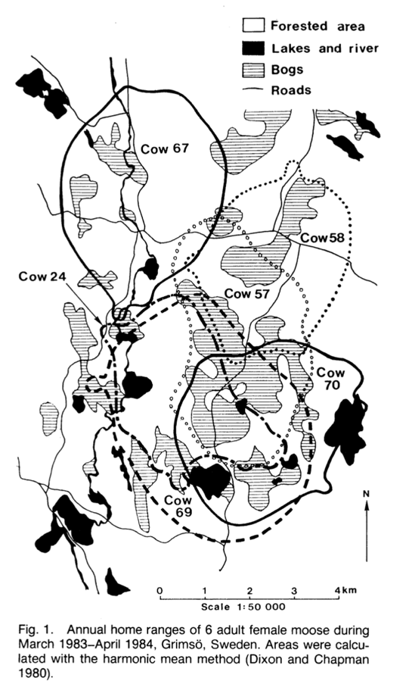
Moose
Cederlund & Okarma 1988 - Home Range and Habitat Use of Adult Female Moose.
Major findings: All females had home ranges that overlapped with one or more collared moose. During marking and aerial surveys in winter, the females were frequently observed in the same habitats, but not together.

Slide 15
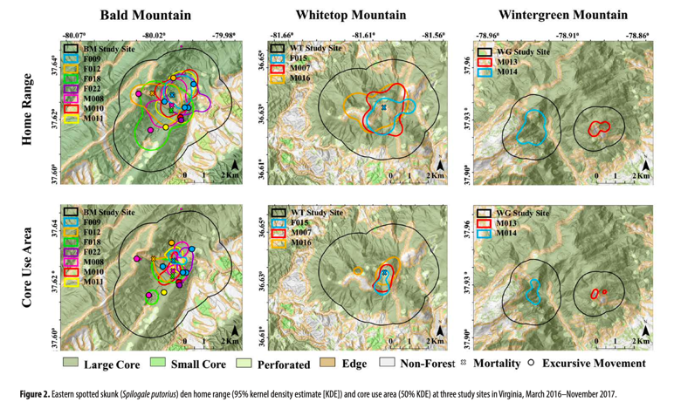
Eastern Spotted Skunk
Thorne et al. 2024 - Home range size and resource use by eastern spotted skunks in Virginia.
Major findings: Skunk home range overlap could be affected by habitat quality of the three different study sites. The highest overlap occurred at Bald Mountain, which had smaller core forest areas that were conducive to skunk movement.

Slide 16
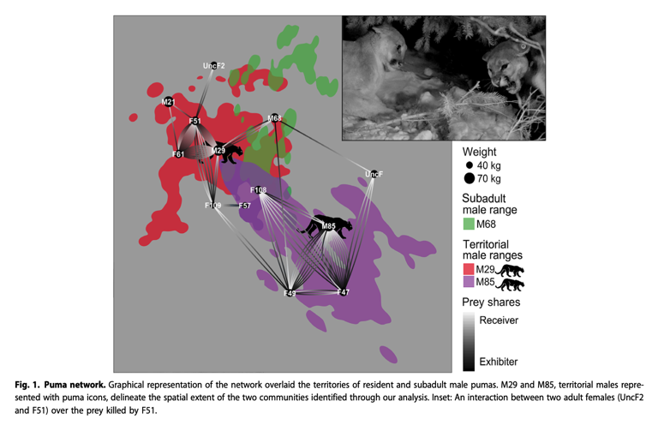
Mountain Lion
Elbroch et al. 2017 - Adaptive social strategies in a solitary carnivore.
Major findings: The greater the spatial overlap between two pumas, the more likely they were to be connected in the network. This descriptive analysis did not indicate any correlation between kinship and tolerance. Puma pairs with overlapping territories exhibited tolerance more than nonoverlapping pairs and that males were more likely to receive toler- ance (in-degree) and less likely to exhibit tolerance at their own kills (out-degree) than females.

Slide 17
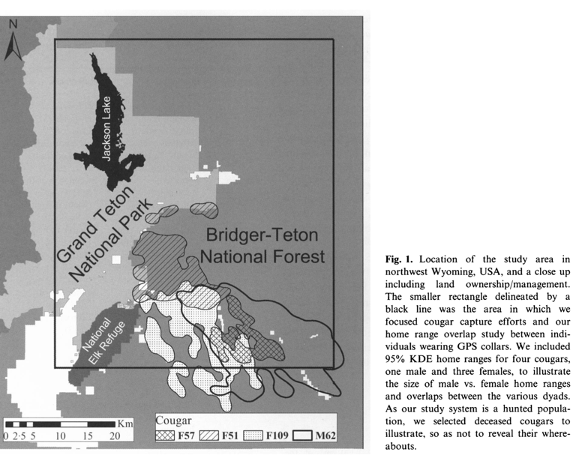
Mountain Lion
Elbroch et al. 2016 - Spatial overlap in a solitary carnivore: support for the land tenure, kinship or resource dispersion hypotheses?
Major findings: Increased resource density over smaller spatial extents in winter appeared to explain spatial overlap between cougars, especially between adult females. The fact that kinship neither explained patterns of spatial overlap reported here, nor spatial associations in Elbroch, Quigley & Caragiulo (2014), may indicate that cougars and other solitary carnivores may be more tolerant of sharing key resources with unrelated conspecifics than previously believed, or at least during periods of high resource availability. Associations and spatial overlap between unrelated carnivores in areas and at times when prey are aggregated provide strong support for the application of the resource dispersion hypothesis to solitary carnivores.

Slide 18
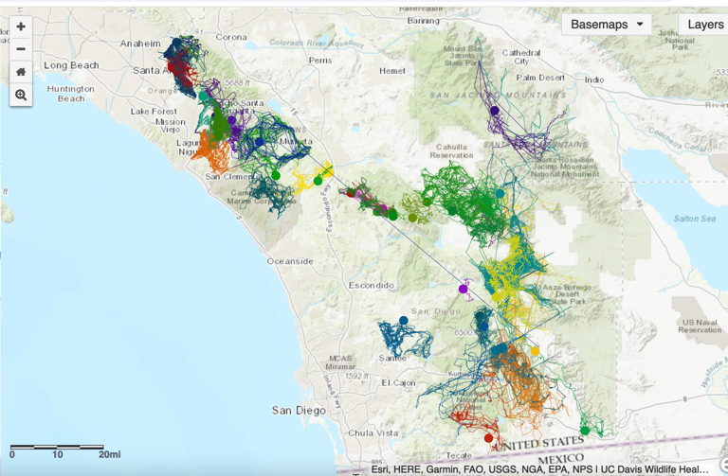
Mountain Lion
UC Davis Wildlife Health Center. (2016). Cougar Tracking Data: Movements of mountain lions in Southern California from 2001 to 2016. Retrieved from https://cougar.codefornature.org

Slide 19
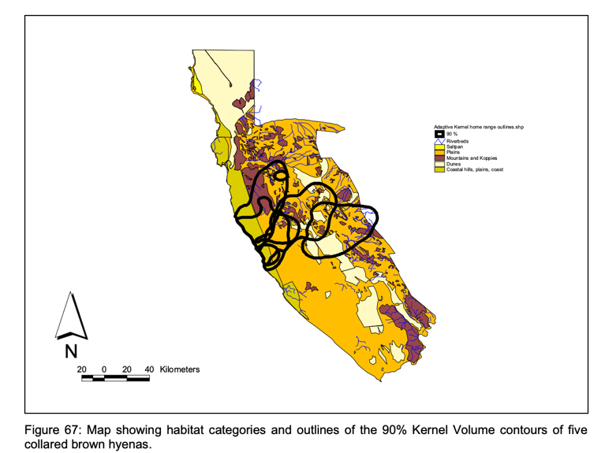
Brown Hyena
Wiesel 2007 - Demography of Brown Hyenas in Inland Areas of the Sperrgebiet, Namibia.
Major findings: Home ranges overlapped greatly, but no data regarding sociality could be analyzed, due to the different time frames of collar deployment.

Slide 20
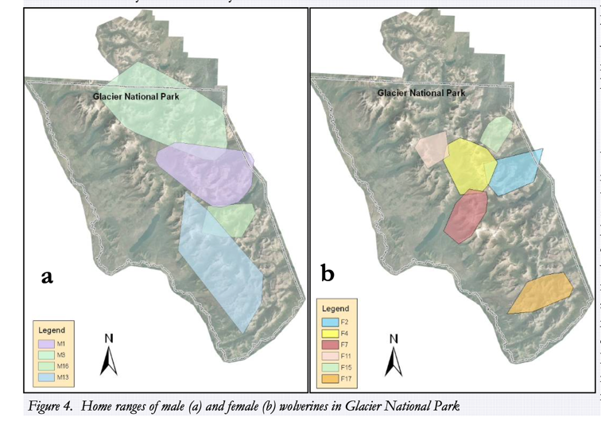
Wolverine
Copeland & Yates 2008 - Wolverine population assessment in Glacier National Park, Comprehensive Summary Update.
Major findings: Male home range size was larger than those of females. Authors documented over 60 instances in which collared wolverines were found together or nearby, not including pairings between males and females during mating season. 17 instances occurred between M1 and his offspring.

Slide 21
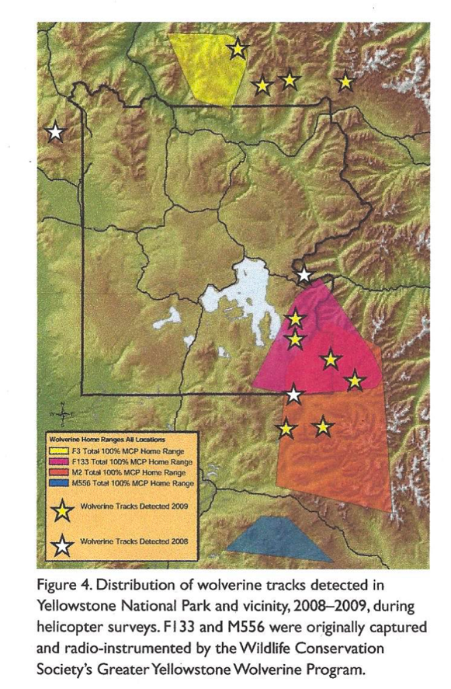
Wolverine
Murphy et al. 2011 - Wolverines in Greater Yellowstone.
Major findings: Overlap between the resident male (orange) and resident female (red) was substantial, similar to that found in other studies (Magoun 1985; Inman et al. 2007; Copeland 1996). Home range size was larger than those found in other studies, possibly because individuals were unconfined by same-sex individuals with adjacent ranges.

Slide 22
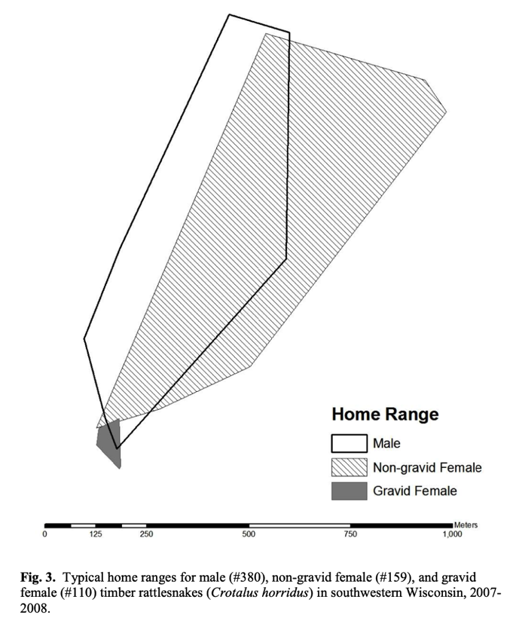
Timber Rattlesnake
Hamilton 2009 - Home range size and habitat selection of timber rattlesnakes (Crotalus horridus) in southwestern Wisconsin.
Major findings: Gravid females sought out specific habitats for egg-laying which greatly narrowed their home range size. Non-gravid female and male home range sizes were similar, but mechanisms driving home range size for males may be different than females.

Slide 23
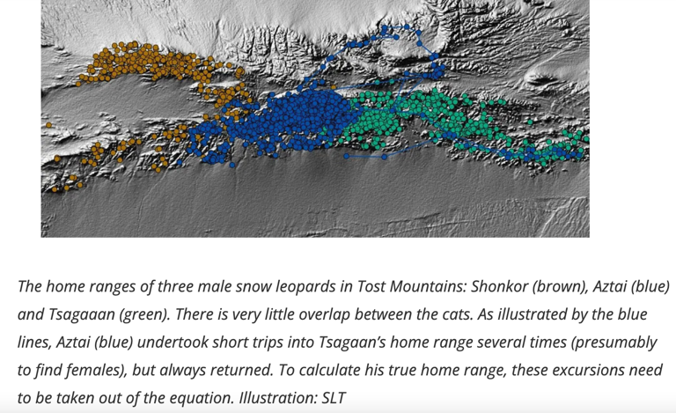
Snow Leopard
Johansson & Fiechter 2016 - "Understanding Home Ranges." Snow Leopard Trust, https://snowleopard.org/understanding-home-ranges/.
Major findings: Collared leopards moved around substantially until they were about three years old, after which they settled into more stable home ranges. If a cat shifted to a new area and settle there, the authors treated it as a permanent move, and calculated a new, separate long-term home range.

Slide 24
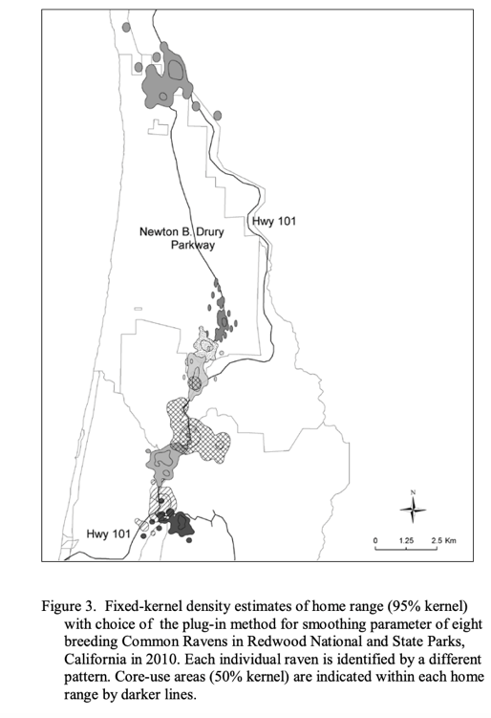
Common Raven
Scarpignato 2011 - Home range and habitat use of breeding Common Ravens in Redwood National and State Parks.
Major findings: There was little home range overlap between adjacent ravens. The small areas of overlap centered on anthropogenic food sources that occurred at adjacent territory boundaries.

Slide 25
References
Murphy, K., Wilmot, J., Copeland, J., Tyers, D., and J. Squires. 2011. Wolverines in Greater Yellowstone. Yellowstone Science 19(3).
Copeland, J. P. and R. E. Yates. 2008. Wolverine population assessment in Glacier National Park, Comprehensive Summary Update. Report to the USDA Forest Service, Rocky Mountain Research Station, Missoula, MT.
Elbroch LM, Levy M, Lubell M, Quigley H, Caragiulo A (2017). Adaptive social strategies in a solitary carnivore. Sci Adv 3: e1701218.
Elbroch, L. M., Lendrum, P. E., Quigley, H. and A. Caraguilo. 2016. Spatial overlap in a solitary carnivore: support for the land tenure, kinship or resource dispersion hypotheses? Journal of Animal Ecology 85(2): 487-496
Thorne, E. D., Fies, M. L., and W. M. Ford. 2024. Home range size and resource use by eastern spotted skunks in Virginia. Journal of the Southeastern Association of Fish and Wildlife Agencies 11:206-214
Brunjes, K. J., Ballard, W. B., Humphrey, M. H., Harwell, F., McIntyre, N. E., Krausman, P. R. and M. C. Wallace. 2009. Home-range size and overlap of sympatric male mule and white-tailed deer in Texas. Western North American Naturalist 69(1): 125-130
Cederlund, G. N., & Okarma, H. (1988). Home Range and Habitat Use of Adult Female Moose. The Journal of Wildlife Management, 52(2), 336-343.
Riley, S. P. D. (2006). Spatial Ecology of Bobcats and Gray Foxes in Urban and Rural Zones of a National Park. The Journal of Wildlife Management, 70(5), 1425-1435.
Grinder, M. I., & Krausman, P. R. (2001). Home Range, Habitat Use, and Nocturnal Activity of Coyotes in an Urban Environment. The Journal of Wildlife Management, 65(4), 887-898.
Hamilton, C. M. (2009). Home range size and habitat selection of timber rattlesnakes (Crotalus horridus) in southwestern Wisconsin. (Master's thesis). University of Wisconsin-Stevens Point, College of Natural Resources.
Mattisson, J., Sand, H., Wabakken, P., Gervasi, V., Liberg, O., Linnell, J. D. C., Rauset, G. R., & Pedersen, H. C. (2013). Home range size variation in a recovering wolf population: Evaluating the effect of environmental, demographic, and social factors. Oecologia, 173(3), 813–825.
Esri Canada. (2024). Wolf Tracks: More than 30,000 tracking points from three wolf individuals, January 9th to May 14, near Fort McMurray, Alberta. ArcGIS StoryMaps. Retrieved from https://storymaps.arcgis.com/stories/32412cf13731440582fe051cd360b009
Loveridge, A. J., Valeix, M., Davidson, Z., Murindagomo, F., Fritz, H., & Macdonald, D. W. (2009). Changes in home range size of African lions in relation to pride size and prey biomass in a semi-arid savanna. Ecography, 32(6), 953–962.
Wiesel, I. (2007). Demography of Brown Hyenas in Inland Areas of the Sperrgebiet, Namibia. Final Report.
Snow Leopard Trust. "Understanding Home Ranges." Snow Leopard Trust, https://snowleopard.org/understanding-home-ranges/. Accessed 26 Dec. 2024.
Crupi, Anthony P., Rodney W. Flynn, LaVern R. Beier, David P. Gregovich, and Jason N. Waite. 2014. Movement Patterns, Home Range Size, and Resource Selection of Brown Bears Near the Malaspina Glacier, Southeast Alaska. Alaska Department of Fish and Game, Final Wildlife Research Report.
Scarpignato, A. L. (2011). Home range and habitat use of breeding Common Ravens in Redwood National and State Parks (Master's thesis, Humboldt State University).

